Slide 1

RECOMMENDATION SYSTEM

Slide 2
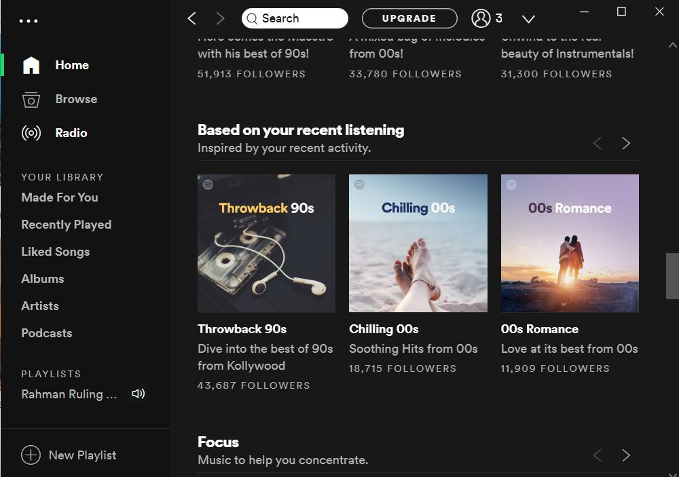

Slide 3
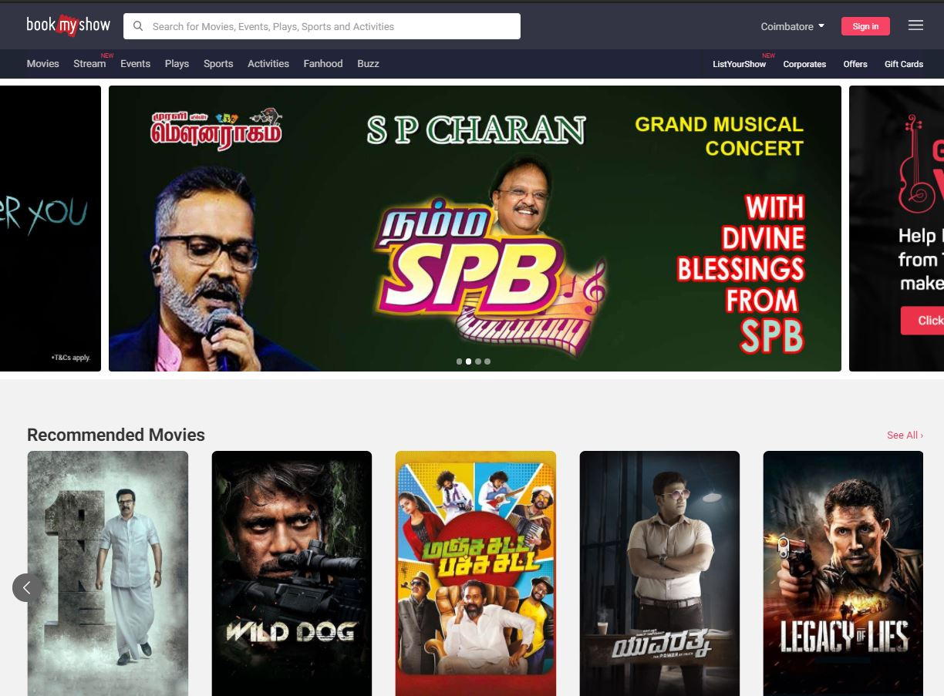

Slide 4
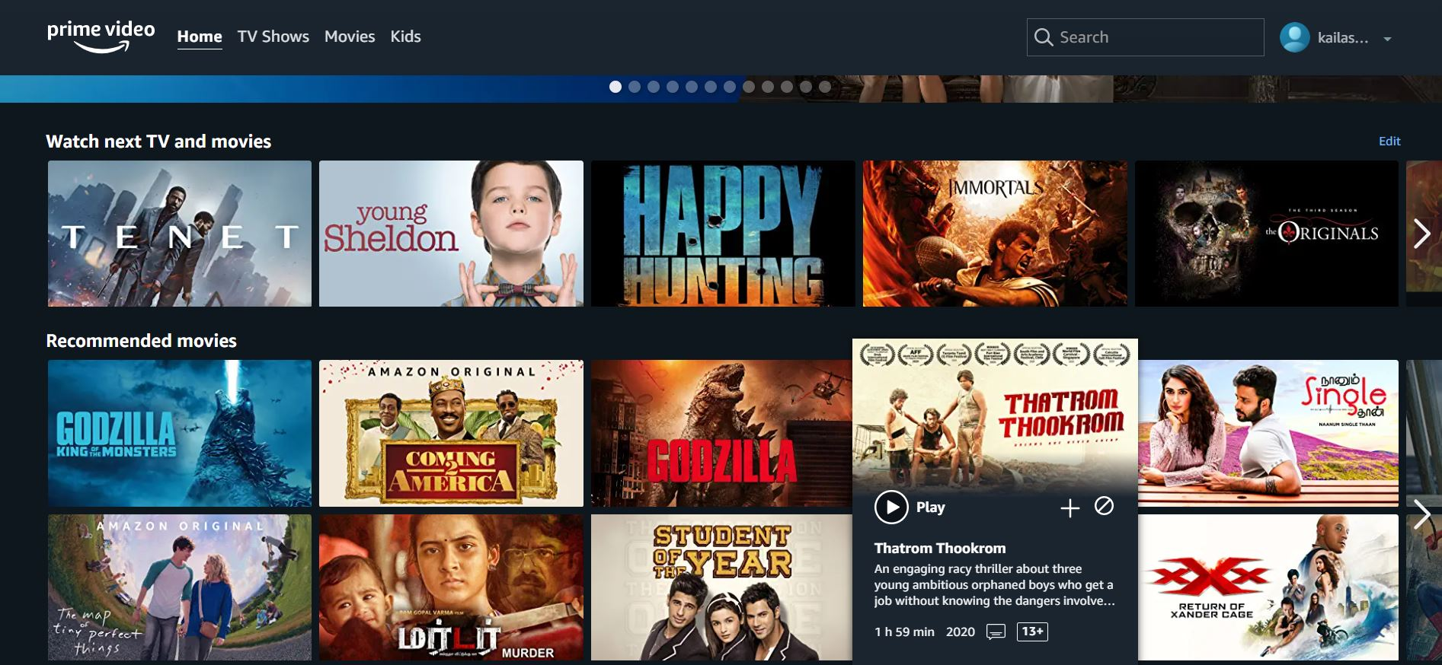

Slide 5
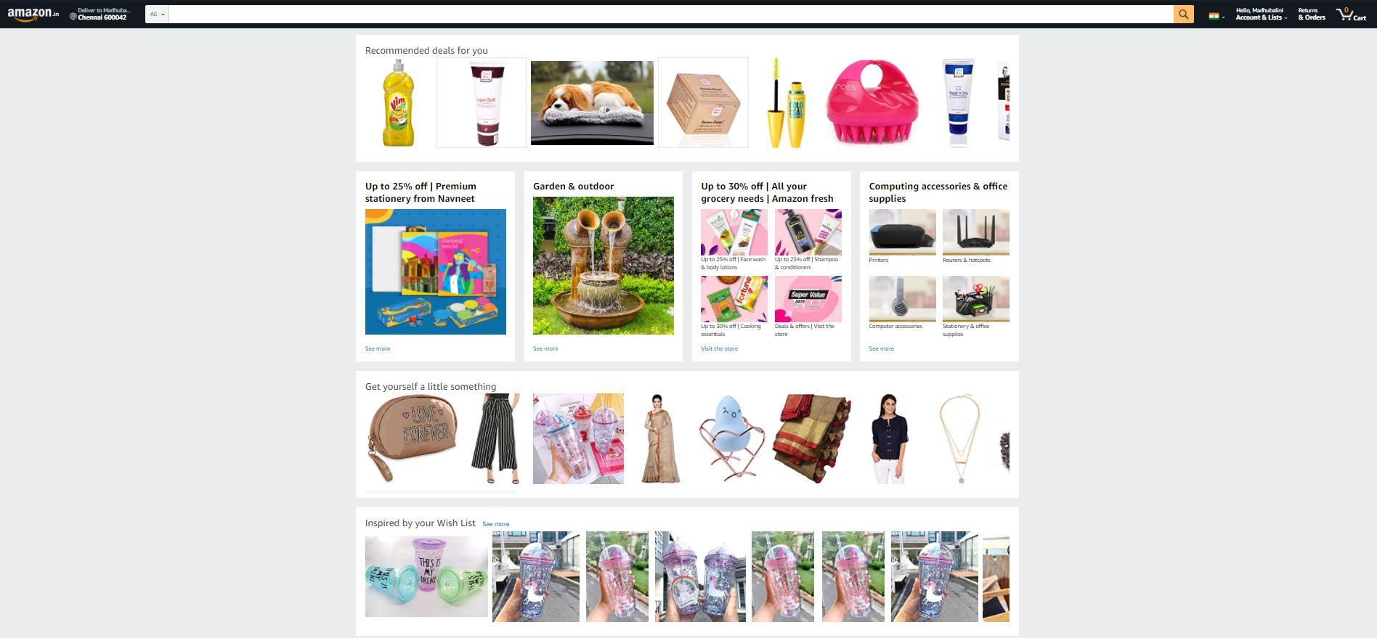

Slide 6
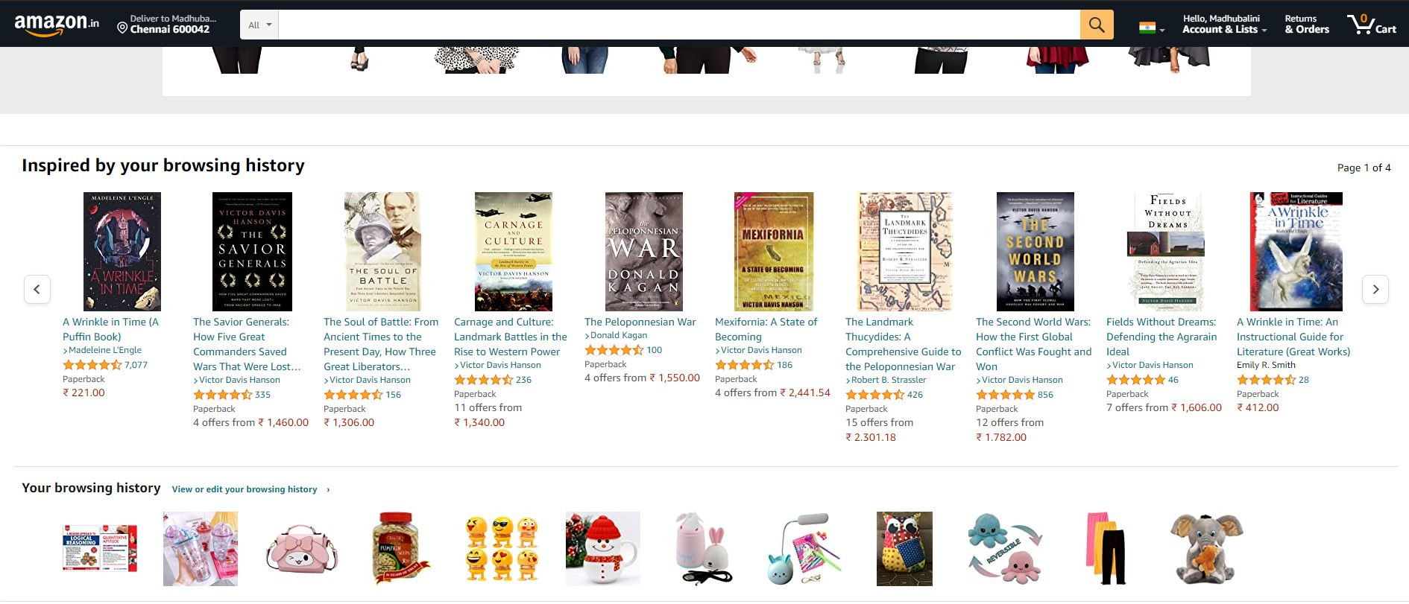

Slide 7
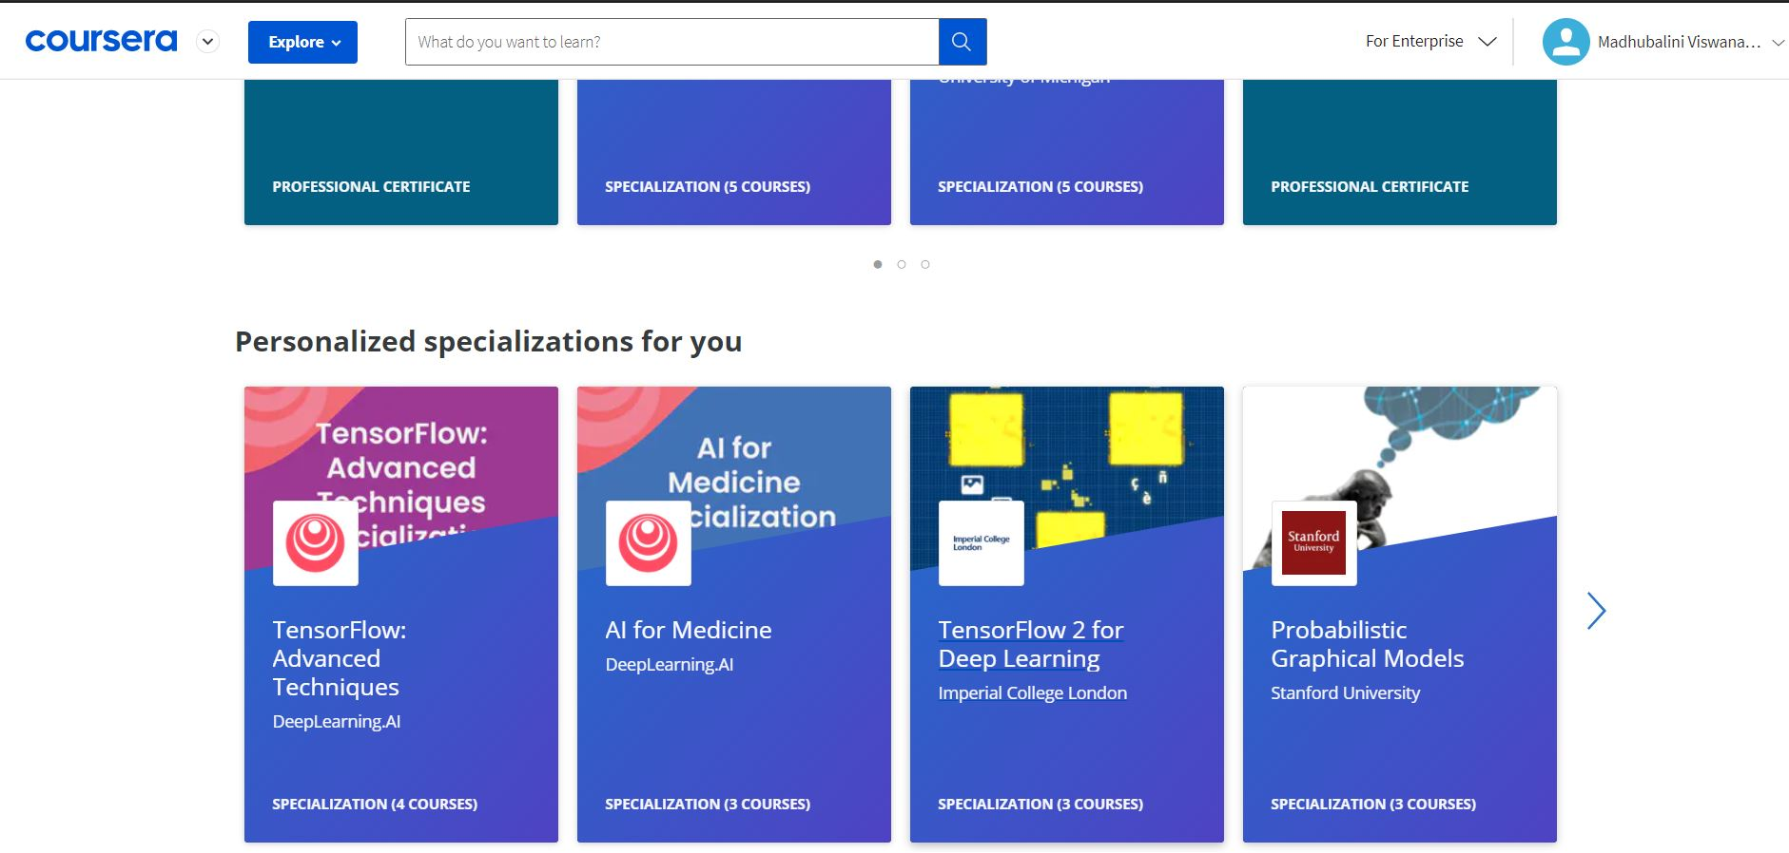

Slide 8
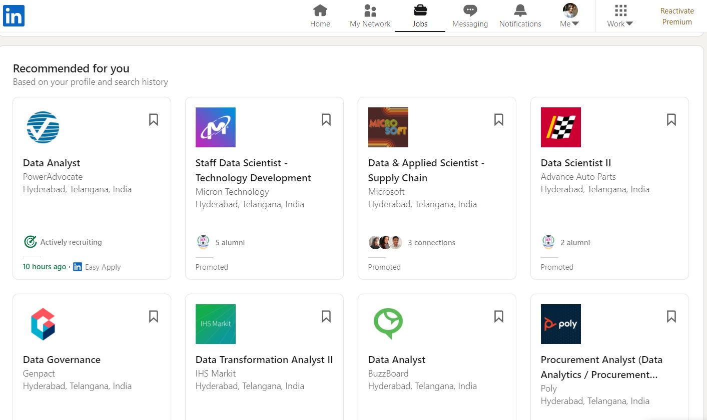

Slide 9
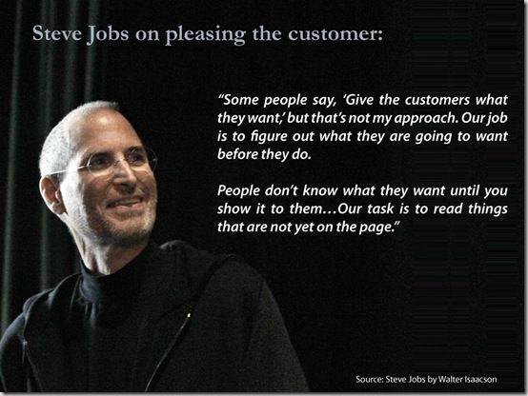

Slide 10
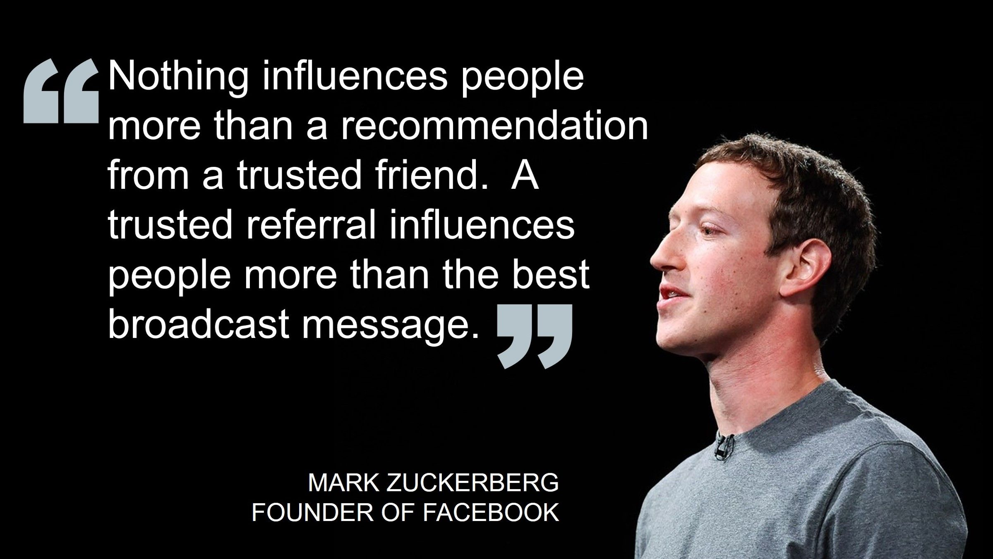
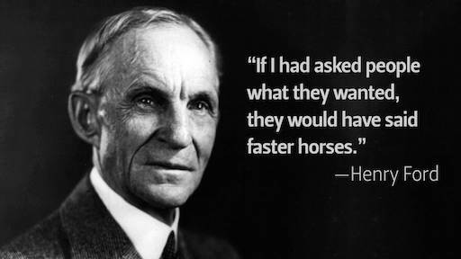

Slide 11
WHY WE CARE ABOUT RECOMMENDATION SYSTEM?
Online business platforms like, Netflix,Amazon,Flipkart.. drive significant engagement with customers and revenue.
It is considered the robust method for business in the era of internet.

Slide 12
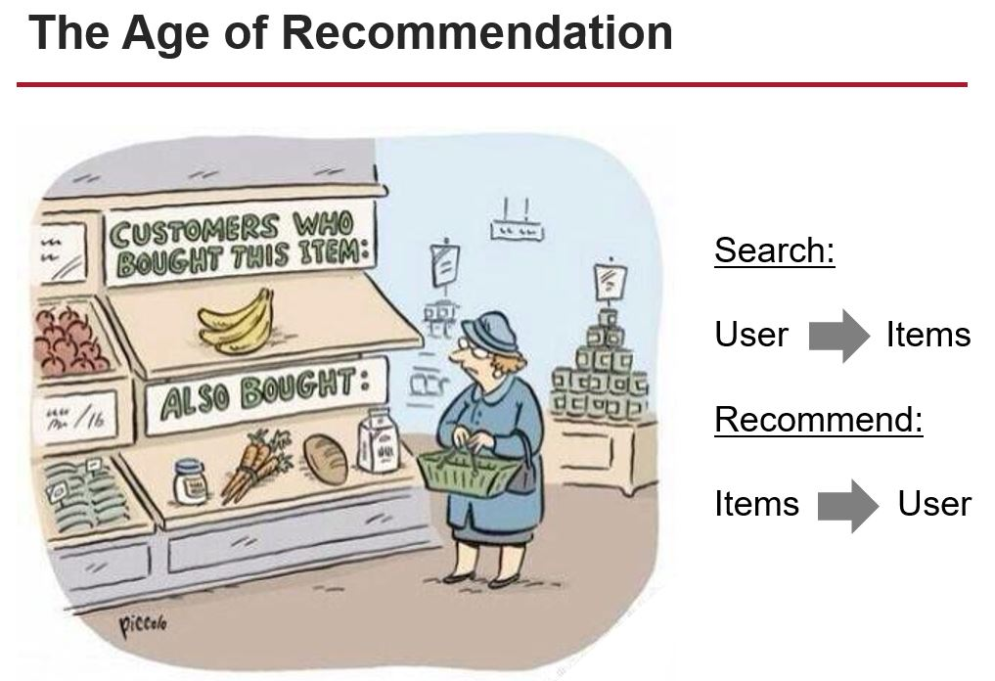
WHAT THIS SYSTEM DOES?
Recommendation system basically studies user activities and suggest new things/products similar to user taste which is not previously seen.
An online company could make about 30-35% profit through recommendation.

Slide 13
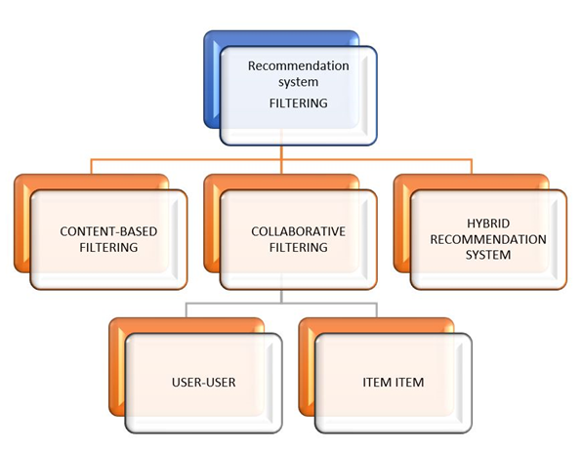

Slide 14
Content-based approach requires a good amount of information of items’ own features, rather than using users’ interactions and feedbacks. For example, it can be movie attributes such as genre, year, director, actor etc., or textual content of articles that can extracted by applying Natural Language Processing.
Collaborative Filtering, on the other hand, doesn’t need anything else except users’ historical preference on a set of items. Because it’s based on historical data, the core assumption here is that the users who have agreed in the past tend to also agree in the future. In terms of user preference, it usually expressed by two categories.
Explicit Rating, is a rate given by a user to an item on a sliding scale, like 5 stars for Titanic. This is the most direct feedback from users to show how much they like an item.
Implicit Rating, suggests users preference indirectly, such as page views, clicks, purchase records, whether or not listen to a music track, and so on. In this article, I will take a close look at collaborative filtering that is a traditional and powerful tool for recommender systems.

Slide 15
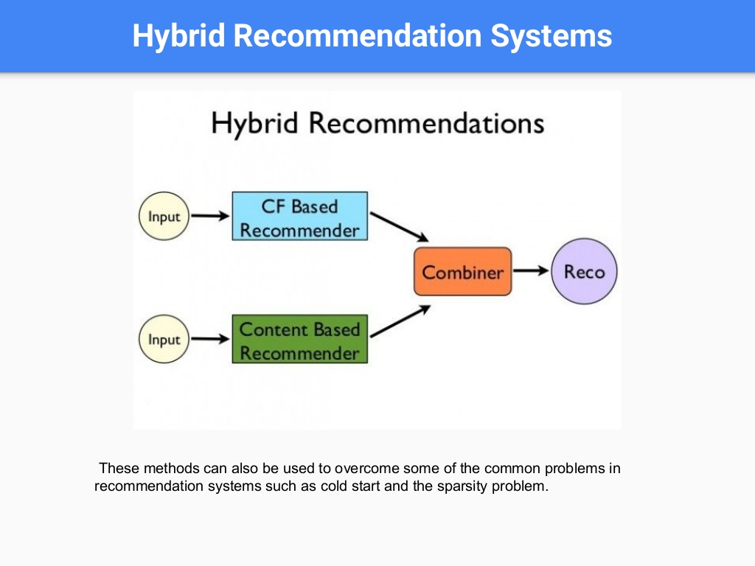
Collaborative filtering
This method finds a group of users who have similar taste and activity of preference, and using this group to recommend products. Uses user behavior (interactions) in addition to item attributes.
User-based, which measures the similarity between target users and other users.
Item-based, which measures the similarity between the items that target users rate or interact with and other items.
Content based system
This method recommend recommend items similar to those the user have liked in past data(history).
Hybrid Model
Recent research has demonstrated that a hybrid approach, combining collaborative filtering and content-based filtering could be more effective than pure approaches in some cases. These methods can also be used to overcome some of the common problems in recommender systems such as cold start and the sparsity problem.

Slide 16
Collaborative Filtering
In Collaborative Filtering, we tend to find similar users and recommend what similar users like. In this type of recommendation system, we don’t use the features of the item to recommend it, rather we classify the users into the clusters of similar types, and recommend each user according to the preference of its cluster.
Measuring Similarity:
Cosine based similarity.
Correlation based similarity.
Euclidean distance.
Normalising vector:
Multiply the vector component by inverse frequency.
Inverse frequency is the inverse of total number of users rated.

Slide 17

COSINE BASED SIMILARITY
A commonly used approach to match similar documents is based on counting the maximum number of common words between the documents.
But this approach has an inherent flaw. That is, as the size of the document increases, the number of common words tend to increase even if the documents talk about different topics.
The cosine similarity helps overcome this fundamental flaw in the ‘count-the-common-words’ or Euclidean distance approach.

Slide 18
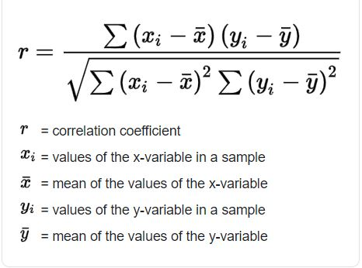
PEARSON CORRELATION
It tells us how much two items are correlated. Higher the correlation, more will be the similarity. Pearson’s correlation can be calculated using the following formula:

Slide 19
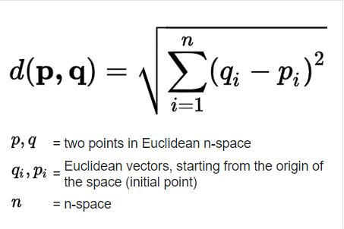
EUCLIDEAN DISTANCE
Similar items will lie in close proximity to each other if plotted in n-dimensional space. So, we can calculate the distance between items and based on that distance, recommend items to the user. The formula for the euclidean distance is given by:

Slide 20
Below is a simplified process for doing this.
Begin by cleaning the data.
Merge datasets
In this case, we have two data,combine the two datasets for metadata.
Create vectors
Create vectors using TF-IDF. Term frequency-inverse document frequency (TF-IDF) is a technique that gives more importance to rare words and less importance to stop words such as prepositions etc. This helps improve recommendation accuracy.
Calculate similarity with TF-IDF matrix to TF-T=IDE matrix.
Now build a function that classifies or ranks the item based on the similarity score.
The function is the input that gives the required recommendation.
All the functions and formulae mentioned here can be done with python with simple line of code, so no need to worry about memorising the formulae.

Slide 21
Thank you!

